Slide 1

International Business: The New Realities
Fifth Edition
Chapter 3
The Cultural Environment of International Business
Copyright © 2020 Pearson Education, Inc. All Rights Reserved

Slide 2
Learning Objectives
3.1 Understand culture and cross-cultural risk.
3.2 Learn the dimensions of culture.
3.3 Describe the role of language and religion in culture.
3.4 Describe culture’s effect in international business.
3.5 Learn models and explanations of culture.
3.6 Understand managerial implications of culture.

Slide 3
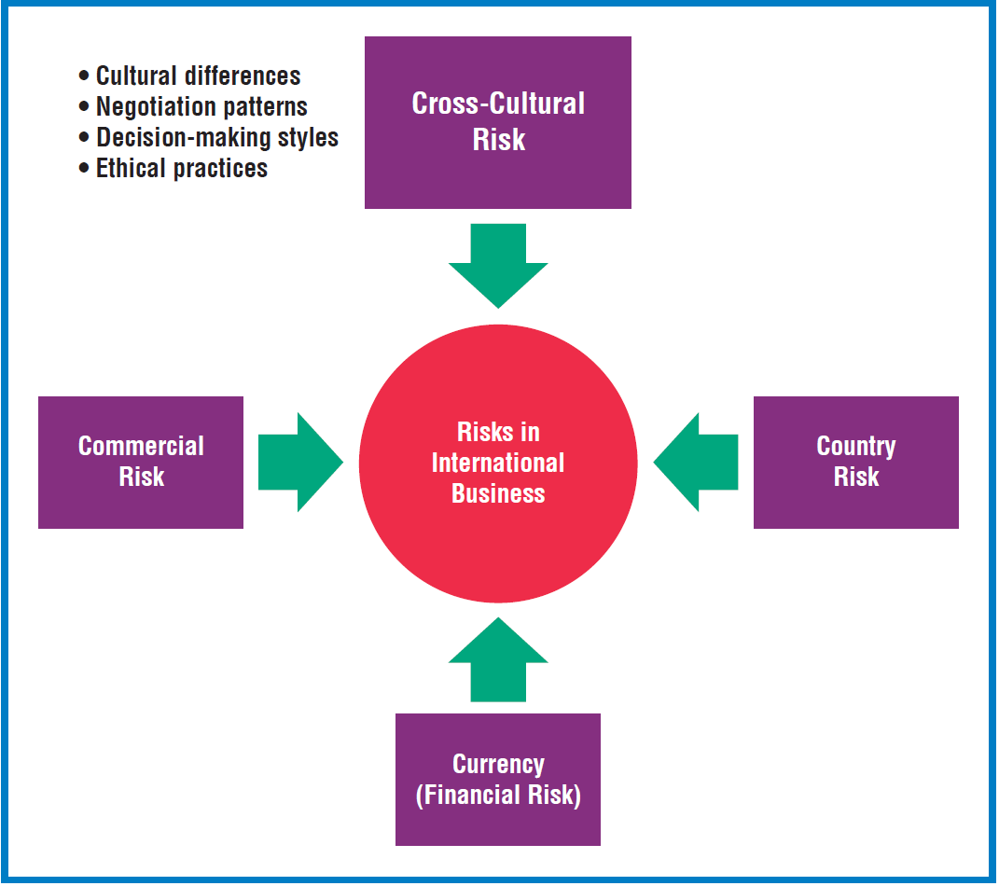
The Four Risks of International Business

Slide 4

Key Concepts
Culture: The values, beliefs, customs, arts, and other products of human thought and work that characterize the people of a given society.
Cross-cultural risk: A situation or event where a cultural miscommunication puts some human value at stake. It arises in environments comprised of unfamiliar languages, and unique values, beliefs, and behaviors
Socialization: The process of learning the rules and behavioral patterns appropriate to one's society.
Acculturation: The process of adjusting and adapting to
a culture other than one's own; commonly experienced
by expatriate workers.
Notes:
Cross-cultural risk occurs when a cultural misunderstanding puts some human value at stake. Cross-cultural risk arises from differences in language, lifestyles, mindsets, customs, and religion. Values unique to a culture tend to be long-lasting and transmitted from one generation to the next. These values influence the mind-set and work style of employees and the shopping patterns of buyers. Foreign customer characteristics differ significantly from those of buyers in the home market.
Language is a critical dimension of culture. In addition to facilitating communication, language is a window on people’s value systems and living conditions. For example, Inuit (Eskimo) languages have various words for snow, while the South American Aztecs used the same basic word stem for snow, ice, and cold. When translating from one language to another, it is often difficult to find words that convey the same meanings. For example, a one-word equivalent to aftertaste does not exist in many languages. Such challenges impede effective communication and cause misunderstandings. Miscommunication due to cultural differences gives rise to inappropriate business strategies and ineffective relations with customers. Cross-cultural risk most often occurs in encounters in foreign countries. However, the risk also can occur domestically, as when management meets with customers or business associates who visit company headquarters from abroad.

Slide 5

Culture Is…
Not right or wrong – It is relative. There is no cultural absolute. Different nationalities simply perceive the world differently.
Not about individual behavior – It is about groups. It is a collective phenomenon of shared values and meanings.
Not inherited – It derives from the social environment. We are not born with a shared set of values and beliefs; we acquire them as we grow up.

Slide 6
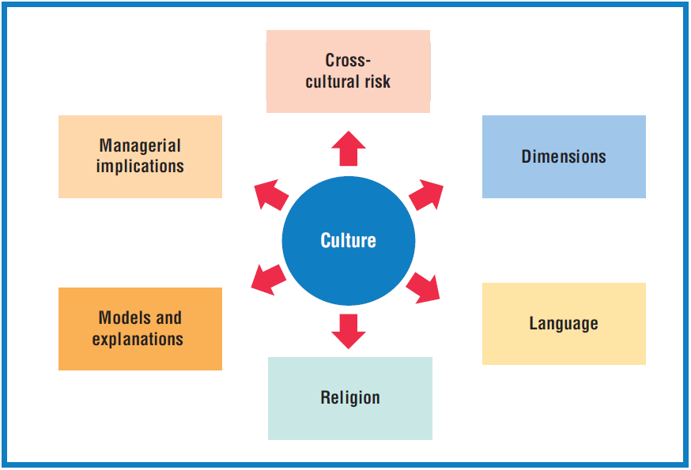
Essential Elements of Culture

Slide 7
Key Dimensions of Culture
Values represent a person’s judgments about what is good or bad, acceptable or unacceptable, important or unimportant, and normal or abnormal.
Attitudes and preferences are developed based on values, and are similar to opinions, except that attitudes are often unconsciously held and may not have a rational basis.
Examples
Values common to Japan, North America, and Northern Europe include hard work, punctuality, and wealth acquisition.

Slide 8
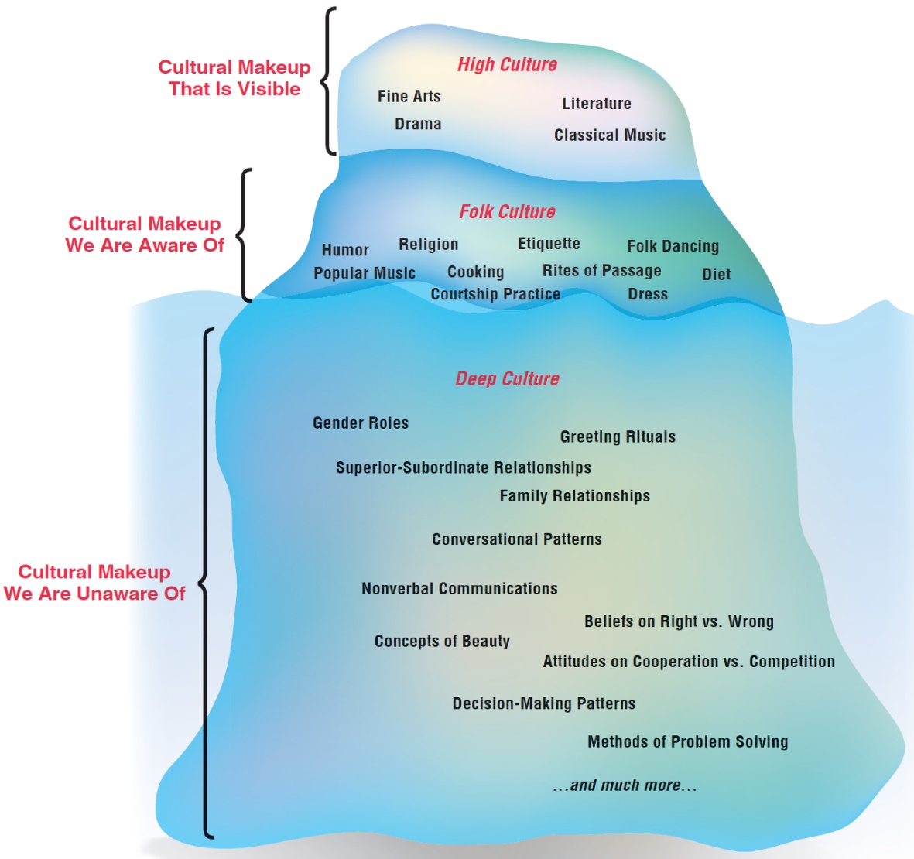
Culture as an Iceberg
Notes:
Anthropologists use the iceberg metaphor to call attention to the many dimensions of culture, some obvious and some not so obvious. Above the surface, certain characteristics are visible, but below, invisible to the observer, is a massive base of assumptions, attitudes, and values. These invisible characteristics strongly influence decision making, relationships, conflict, and other dimensions of international business. We are usually unaware of the nine-tenths of our cultural makeup that exists below the surface. In fact, we are often not aware of our own culture unless we meet another one.

Slide 9

Manners, Customs, Perceptions of Space
Manners and customs refer to ways of behaving and conducting oneself in public and business situations. They are present in eating habits, mealtimes, work hours and holidays, drinking and toasting, appropriate behavior at social gatherings (kissing, handshaking, bowing), gift-giving (complex), the role of women, and much more.
Perceptions of space reflects
each culture’s orientation
about personal space and
conversational distance.

Slide 10
Perceptions of Time
Time dictates expectations about planning, scheduling, profit streams, and what constitutes tardiness in arriving for work and meetings.
Monochronic - A rigid orientation to time in which the individual is focused on schedules, punctuality, time as a resource, time is linear, “time is money”. For example, people in the U.S. are hurried and impatient.
Polychronic - A flexible, non-linear orientation to time in which the individual takes a long-term perspective; time is elastic, long delays are tolerated before taking action. Punctuality is relatively unimportant. Relationships are valued.
Examples: Africa, Latin America, Asia.

Slide 11
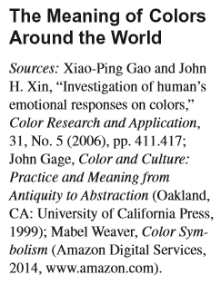
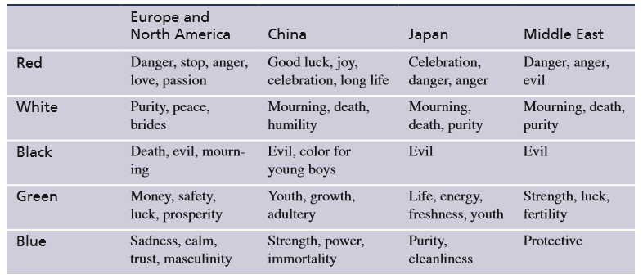
Symbolic and Material Productions
A symbol can be letters, figures, colors, or other characters that communicate a meaning. Examples include flags, anthems, seals, monuments, and even historical myths.
Material productions are artifacts, objects, and technological systems that people construct to function in their environments.
Notes:
Colors are important and powerful communication tools that express emotions and feelings. Colors are one of the most influential factors that affect perceptions in branding and advertising. Companies must choose color schemes carefully when developing product features, advertising, packaging, and marketing programs. When buyers encounter a product for the first time, the perception of the product is significantly influenced by its color.

Slide 12

Social Structure
Social structure is the pattern of social arrangements and organized relationships that characterize a society. Society is organized as:
Individuals
Family
Reference groups
Social stratification
Social mobility

Slide 13
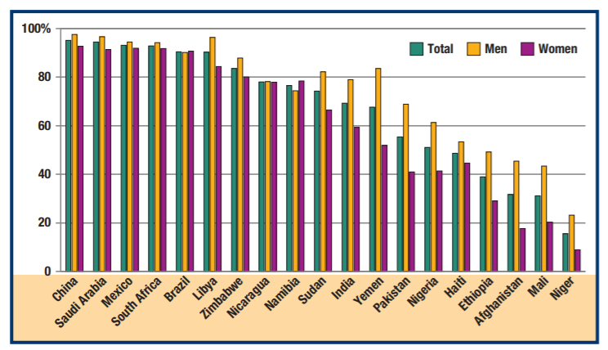
Literacy Rates in Selected Countries
(% of those who can read)
Sources: Central Intelligence Agency, The World Factbook 2018 (Washington, DC: Central Intelligence Agency, 2018); United Nations, UNICEF Global Databases, 2017, http://data.unicef. org; UNESCO, Effective Literacy and Numeracy Practices Database (LitBase), http://litbase.uil.unesco. org/, accessed January 5, 2018.
Notes:
Literacy, the ability to read, is an important indicator of education level and varies substantially around the world. The Exhibit shows literacy rates in selected countries. The literacy rate is higher for men than for women in many developing economies. This arises for various reasons, often related to culture, religion, nation-level conflicts, and socioeconomic factors. In the African country of Sudan, for example, 82 percent of men are literate compared to 66 percent of women. This disparity results partly because Sudan is a male-dominated society in which women tend to take on subordinate roles and have limited opportunities to attend school. Women are expected to bear and raise children and perform domestic chores in the home. Educational opportunities in Sudan also have been hindered by war and ethnic strife. In Namibia, another African country, the literacy rate is higher for women than for men, at 78 and 74 percent, respectively. This has resulted partly from government efforts such as the National Literacy Programme to increase citizens’ literacy and communications skills. Programs often target Namibian women, while men concentrate on traditional labor-intensive jobs such as fishing, mining, and agriculture.

Slide 14
Language as a Key Dimension of Culture
The “mirror” or expression of culture; essential for communications; provides insights into culture.
Linguistic proficiency is a great asset in international business.
Language has both verbal and nonverbal (unspoken, facial expressions and gestures).
There are nearly 7,000 active languages, including over 2,000 in each of Africa and Asia.

Slide 15
Most Common Primary Languages in the World (1 of 2)
World Rank | Language | Approximate Number Of Native Speakers (Millions) | Countries with Substantial Number of Native Speakers
1 | Mandarin Chinese | 900 | China, Singapore
2 | Spanish | 435 | Argentina, Mexico, Spain
3 | English | 370 | Australia, Canada, United Kingdom, United States
4 | Hindi | 260 | India
5 | Arabic | 290 | Egypt, Saudi Arabia, United Arab Emirates
6 | Portuguese | 220 | Brazil, Portugal
7 | Bengali | 200 | Bangladesh, India
8 | Russian | 150 | Russia, Kazakhstan. Ukraine

Slide 16
Most Common Primary Languages in the World (2 of 2)
9 | Japanese | 125 | Japan
10 | Punjabi | 100 | India, Pakistan
11 | German | 90 | Germany, Austria
12 | Javanese | 80 | Indonesia
13 | Korean | 75 | South Korea
14 | French | 74 | France, Canada, Belgium, Algeria
15 | Tamil | 70 | India, Sri Lanka
Sources: Gary Simon and Charles Fennig (eds.), Ethnologue: Languages of the World, 20th ed., 2017, www.ethnologue.com; Central Intelligence Agency, CIA World Factbook, 2017, www.cia.gov.

Slide 17

Idioms
An expression whose symbolic meaning differs from its literal meaning; You can’t understand it simply by knowing what the individual words mean. Examples:
  Australia: “The tall poppy gets cut down” (importance of not being showy or pretentious)
  Thailand: “If you follow older people, dogs won’t bite
  you” (wisdom)
  Japan: “The nail that sticks out gets
  hammered down” (group conformity)
Notes:
Appropriate behavior in one culture may be viewed as unethical behavior elsewhere. In China, counterfeiters frequently publish translated versions of imported books without compensating the original publisher or authors, an illegal practice in most of the world. In parts of Africa, accepting expensive gifts from suppliers is acceptable, even if inappropriate elsewhere. In the United States, some CEOs receive compensation hundreds of times greater than that of their most junior employees, a practice widely considered unacceptable. Ethical standards also change over time. Although slavery is no longer tolerated, some multinational firms today tolerate working conditions that are akin to it.

Slide 18
Blunders in International Advertising
Firm and Location | Intended Slogan | Literal Translation
Parker Pen in Latin America | “Use Parker Pen, avoid embarrassment” | “Use Parker Pen, avoid pregnancy!”
Pepsi in Germany | “Come Alive with Pepsi” | “Come out of the grave with Pepsi”
Pepsi in Taiwan | “Come Alive with Pepsi” | “Pepsi brings your ancestors back from the dead”
Fisher Body in Belgium (car exteriors) | “Body by Fisher” | “Corpse by Fisher”
Salem cigarettes in Japan | “Salem-feeling Free” | “Smoking Salem makes your mind feel free and empty”

Slide 19
Meaning Differences between U.S. and British English
Word | Meaning in U.S. English | Meaning in British English
Redundant | repetitive | fired or laid off
Scheme | a somewhat devious plan | a plan
Sharp | smart, clever | conniving, unethical
Windscreen | a screen that protects against the wind | automobile windshield
To table | to put an issue on hold | to take up an issue
To bomb | to fail miserably | to succeed grandly

Slide 20
Nonverbal Communications

Slide 21
Religion
A system of common beliefs or attitudes regarding a being or system of thought that people consider sacred, divine, or the highest truth; and the associated moral values, traditions, and rituals.
Influences culture, and therefore business and consumer behavior.
Example: The “protestant work ethic” emphasizes hard work, individual achievement, and a sense that people can control their environment - the underpinnings for the development of capitalism.

Slide 22
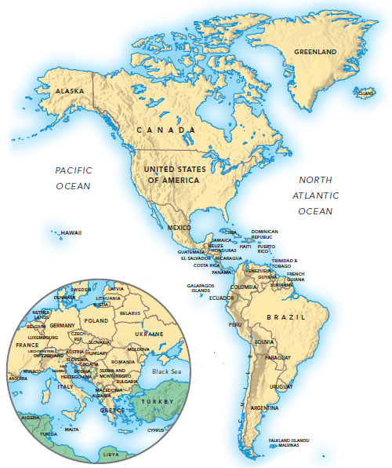
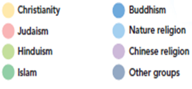
World Religions (1 of 2)
Sources: Based on http://www.godweb.org/religionsofworld.htm and http://www.mapsofworld.com/religion-map.htm

Slide 23
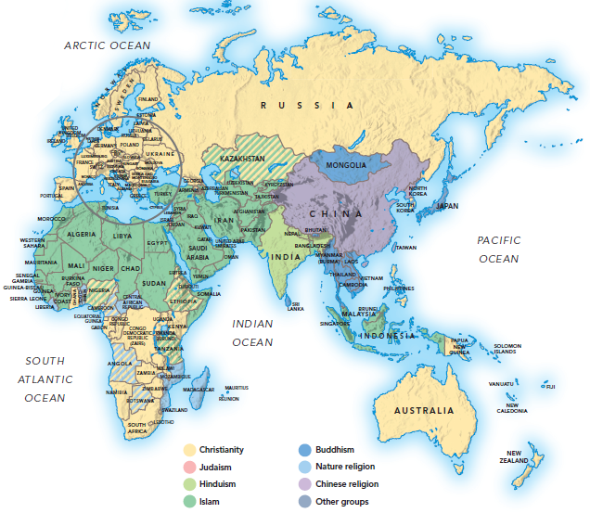
World Religions (2 of 2)

Slide 24

Role of Religion in Islamic Societies (1 of 2)
Islam is the basis for government, legal and social systems. As Muslims view God’s will as the source of all outcomes, they are relatively fatalistic and reactive.
Islam’s holy book, the Qur’an, prohibits drinking alcohol, gambling, usury, and “immodest” exposure. The prohibitions affect firms dealing in various goods.

Slide 25

Role of Religion in Islamic Societies (2 of 2)
Examples
Nokia launched a mobile phone that shows Muslims the direction towards Mecca, Islam’s holiest site.
Heineken rolled out the
non-alcoholic malt drink
Fayrouz.

Slide 26

In Business, Culture Affects:
Managing employees.
Communicating and dealing with distributors and other business partners.
Negotiating and structuring business ventures.
Developing products and services.
Preparing advertising and
promotional materials.
Preparing for international trade fairs.
Interacting with current and
potential customers.
Notes:
Appropriate behavior in one culture may be viewed as unethical behavior elsewhere. In China, counterfeiters frequently publish translated versions of imported books without compensating the original publisher or authors, an illegal practice in most of the world. In parts of Africa, accepting expensive gifts from suppliers is acceptable, even if inappropriate elsewhere. In the United States, some CEOs receive compensation hundreds of times greater than that of their most junior employees, a practice widely considered unacceptable. Ethical standards also change over time. Although slavery is no longer tolerated, some multinational firms today tolerate working conditions that are akin to it.

Slide 27
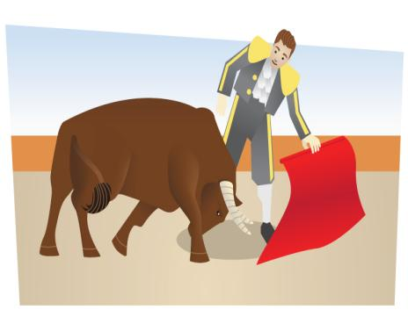
Models and Explanations of Culture
Cultural Metaphors refer to a distinctive tradition or institution strongly associated with a society; a guide to deciphering attitudes, values, and behaviors.
American football represents systematic planning, strategy, leadership, and struggling against rivals.
The Swedish stuga (a summer cottage) represents the love of nature and desire for individualism, in Sweden.
The Spanish bullfight reflects the importance
of ritual, style, courage, and pride in Spain.

Slide 28
E. T. Hall’s High- and Low-Context Cultures
Low-context cultures rely on explicit explanations, with emphasis on spoken words. Such cultures emphasize clear, efficient, logical delivery of verbal messages. Communication is direct. Agreements
are concluded with specific, legal contracts.
High-context cultures emphasize nonverbal or indirect language. Communication aims to promote smooth, harmonious relationships. Such cultures prefer a polite, “face-saving” style that emphasizes a mutual sense of care and respect for others. Care is taken not to embarrass or offend others.
Notes:
When communicating, people in low-context cultures rely heavily on spoken words and detailed verbal explanations. As Exhibit 3.14 shows, Europeans and North Americans tend to be low-context with long traditions of writing and speech making. In such cultures, the main function of speech is to express ideas and thoughts clearly, logically, and convincingly; communication is direct, and meaning is straightforward. In negotiations, for example, Americans typically come to the point quickly. Low-context cultures tend to value expertise and performance. Managers conduct negotiations as efficiently as possible. These cultures use specific, legalistic contracts to conclude agreements. By contrast, high-context cultures, such as China and Japan, emphasize nonverbal messages and view communication as a means to promote smooth, harmonious relationships. They prefer an indirect and polite style that emphasizes mutual respect and care for others. They are on guard not to embarrass or offend others. This helps explain why Japanese people hesitate to say no even when they disagree with what someone is saying. They are more likely to say “it is different,” a softer response.

Slide 29
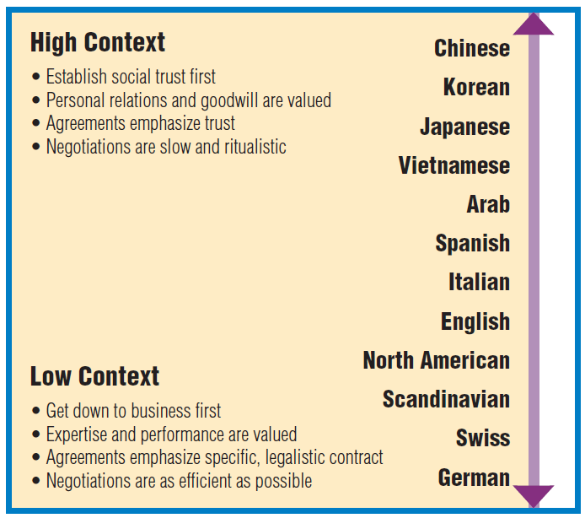
Hall’s High- and Low-Context Typology of Culture
Source: Based on Beyond Culture by Edward T. Hall, copyright © 1976, 1981 by Edward T. Hall. Used by permission of Doubleday, a division of Random House, Inc. For online information about other Random House, Inc. books and authors, seethe Internet Web Site at http://www.randomhouse.com Mark Cleveland, Michel Laroche, and Nicolas Papadopoulos, “You are what you speak? Globalization, multilingualism, consumer dispositions and consumption,” Journal of Business Research, 68No. 3 (2015), pp. 542–552. Donghoon Kim, Yigang Pan, and Heung Soo Park,“High- Versus Low-Context Culture: A Comparison of Chinese, Korean and American Cultures,” Psychology & Marketin, 15 No. 6 (1998), pp. 507–521.

Slide 30
Ethical Connections (1 of 2)
Ethical values vary by culture. Consider two scenarios given to students.
In scenario one, a car salesman failed to inform his superiors about a serious engine problem of a car he had received as trade-in on a new car sale.
In scenario two, a dealership neglected to fully repair a car transmission under warranty in the hope of securing lucrative repair work after the warranty expired.
Students from China and Russia felt relatively little harm had been done in these scenarios. Students from Finland and South Korea judged the scenarios to be unethical.
Source: M. Ahmed, Y. Kung; J. Eichenseher, “Business Students’ Perception of Ethics and Moral Judgment,” Journal of Business Ethics, 33 (2003): 89–102.

Slide 31
Hofstede’s Typology of National Culture
Individualism versus collectivism refers to whether a person primarily functions as an individual or within a group.
In individualistic societies, each person emphasizes his or her own self-interest; competition for resources is the norm; individuals who compete best are rewarded. Examples: Australia, Britain, Canada, and the U.S.
In collectivist societies, ties among individuals are important; business is conducted in a group context; life is a fundamentally cooperative experience; conformity and compromise help maintain harmony. Examples: China, Panama, Japan, South Korea.

Slide 32
Hofstede’s Typology (1 of 5)
Power distance describes how a society deals with inequalities in power that exist among people.
High power distance societies exhibit big gaps between the weak and powerful; in firms, top management tends to be autocratic, giving little autonomy to lower-level employees. Examples: Guatemala, Malaysia, Philippines, and several Middle East countries.
Low-power distance societies have small gaps between the weak and powerful. Firms tend toward flat organizational structures, with relatively equal relations between managers and workers. For example, Scandinavian countries instituted various systems to ensure socioeconomic equality.

Slide 33
Hofstede’s Typology (2 of 5)
Uncertainty avoidance refers to the extent to which
people can tolerate risk and uncertainty in their lives.
High uncertainty avoidance societies create institutions to minimize risk and ensure security. Firms emphasize stable careers and regulate worker actions. Decisions are made slowly. Examples: Belgium, France, Japan
In low uncertainty avoidance societies, managers are relatively entrepreneurial and comfortable with risk. Firms make decisions quickly. People are comfortable changing jobs. Examples: Ireland, Jamaica, U.S.

Slide 34
Hofstede’s Typology (3 of 5)
Masculinity versus femininity refers to a society’s orientation based on traditional male and female values.
Masculine cultures value competitiveness, ambition, assertiveness, and the accumulation of wealth. Both men and women are assertive, focused on career and earning money. Examples: Australia, Japan.
Feminine cultures emphasize nurturing roles, interdependence among people, and caring for less fortunate people – for both men and women. Examples: Scandinavian countries, where welfare systems are highly developed, and education is subsidized.

Slide 35
Hofstede’s Typology (4 of 5)
Long-term vs. short-term orientation describes the degree to which people and organizations defer gratification to achieve long-term success.
Long-term orientation emphasizes the long view in planning and living, focusing on years and decades. Examples: Traditional Asian cultures, such as China, Japan, and Singapore, which base these values on the teachings of the Chinese philosopher Confucius (500 B.C.), who espoused long-term orientation, discipline, hard work, education, and emotional maturity.
Short-term orientation is typical in the United States and most other Western countries.

Slide 36
Hofstede’s Typology (5 of 5)
Indulgence versus restraint describes the degree to which people in a society attempt to control their impulses and desires.
Members of indulgent societies allow relatively free gratification of their basic and natural human desires related to having fun and generally enjoying life.
Restrained societies believe that such gratification should be curbed and regulated by strict norms.
For example, Denmark, Mexico, and the U.S. score
high on indulgence. China, Iraq, and South Korea
score high on restraint.

Slide 37
Deal vs. Relationship Orientation
In deal-oriented cultures, managers focus on the task at hand, are impersonal, typically use contracts, and want to just “get down to business.” Examples: Australia, Northern Europe, and North America.
In relationship-oriented cultures, managers value affiliations with people, rapport, and getting to know the other party in business interactions. Relationships are more important than individual deals; Trust is much valued in business agreements. Examples: China, Japan, Latin American countries. It took nine years for Volkswagen to negotiate a car factory in China.

Slide 38
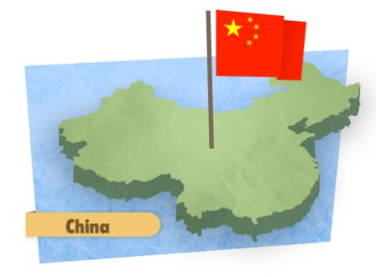
Guanxi: Important in Business in China
Refers to social connections and relationships based on mutual benefits.
Emphasizes reciprocal exchange of favors as well as mutual obligations.
Rooted in ancient Confucian philosophy, which values social hierarchy and reciprocity.
Engenders trust, thereby serving as a
form of insurance in a potentially risky
business environment.

Slide 39
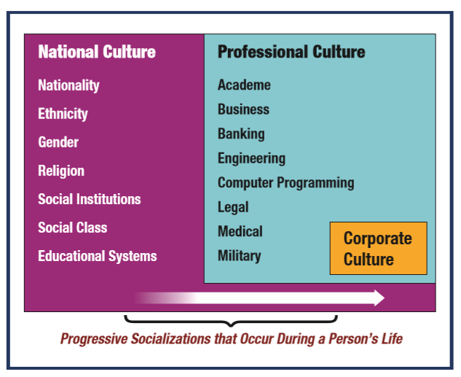
National, Professional, and Corporate Culture
Source: Based on V. Terpstra and K. David, Cultural Environment of International Business, 3rd ed. (Cincinnati, OH: South-Western,1991).

Slide 40
Managerial Orientations
Ethnocentric orientation: Using our own culture as the standard for judging other cultures.
Polycentric orientation: A mindset in which the manager develops a greater affinity for the country in which he or she works than for the home country.
Geocentric orientation: A global mindset in which the manager is able to understand a business or market without regard to national boundaries.
Managers should strive for a geocentric orientation.

Slide 41
Culture is linked with particular groups based on various factors, including:
Geography. Different levels – the world, the nation, the region, cities – elicit unique cultural perspectives.
Ethnicity. For example, people of African, Indian, and Latino heritage tend to perceive reality differently.
Gender. Men and women often experience the world differently.
Age. Seniors, baby boomers, teenagers, and children perceive their worlds differently.
Language. Language both reflects, and is reflected by, cultural differences.
Occupation. Perspectives differ among blue collar workers, professionals, or artists

Slide 42
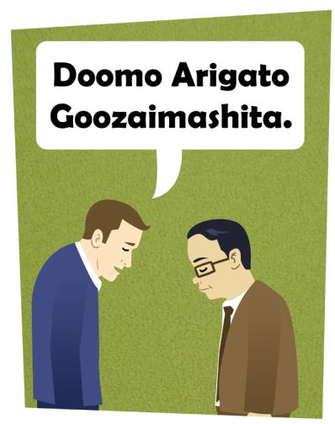
Managerial Guidelines for Cross-Cultural Success
Acquire factual and interpretive knowledge about the other culture; try to speak their language.
Avoid cultural bias.
Develop cross-cultural skills,
such as perceptiveness,
interpersonal skills, adaptability

Slide 43
Managerial Guidelines
Self-reference criterion: The tendency to view other cultures through the lens of one's own culture- understanding this is the first step.
Critical incident analysis: A method for analyzing awkward situations in cross cultural interactions by developing empathy for other points of view.
  Identify situations where you need to be culturally aware to interact effectively with people from another culture.
  When confronted with “strange” or awkward behavior, discipline yourself to not make judgments.
  Develop your best interpretation of the foreigner’s behavior, and formulate your response.
  Learn from this process and continuously improve.

Slide 44
Personality Traits for Cross-Cultural Proficiency
Tolerance for ambiguity: Ability to tolerate uncertainty
and lack of clarity in the thinking and actions of others.
Perceptiveness: Ability to closely observe and comprehend subtle information in the speech and behavior of others.
Valuing personal relationships: Ability to appreciate personal relationships; which are often more important than achieving one-time goals or “winning” arguments.
Flexibility and adaptability: Ability to be creative in
devising innovative solutions, be open-minded about outcomes, and show “grace under pressure”.

Slide 45
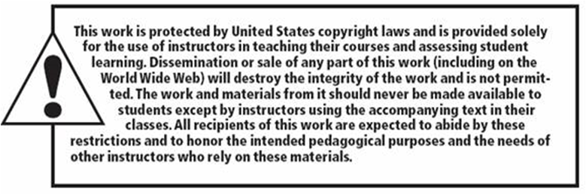
Copyright

